Slide 1







bystander INTERVENTION

Slide 2
Welcome

Slide 3


Overview
  Understand what Bystander Intervention is.
  Develop the skills, strategies, and confidence to intervene when safe.
  Recognise problematic behaviour.
  Learn more about the different ways to interrupt.
  Learn how to be an active bystander.
Trigger warning
Some content in this training might be triggering

Slide 4
What is a bystander?
Notes:
Listed in slide are CYP’s answers.
Check if CYP want to add anymore answers to this slide or would like to edit anything.
3

Slide 5








What is a Bystander?
Someone who is told about a situation
Someone who Is not directly involved in the situation.
E.g. Someone who witnesses bullying, either in person or online is a bystander.
Someone who is witness to a situation

Slide 6

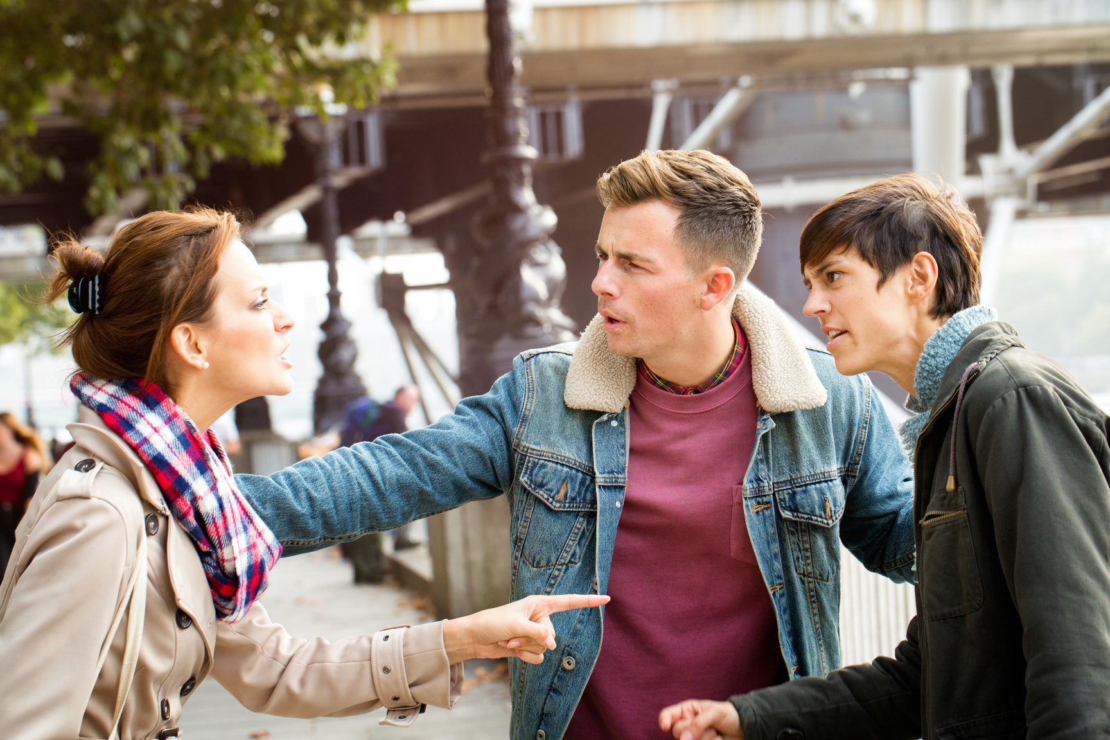
Active or Passive Bystander
Passive
Active
A
B
A passive bystander is someone who witnesses negative behaviour but does nothing.
An active bystander is someone who choses to act when they witness negative behaviour.

Slide 7




The Four stages of intervention
Think that it is as a problem
Feel responsible for helping
Notice the event
Know how to help
(Adapted from Berkowitz, A. (2009) Response Ability: A Complete Guide to Bystander Intervention, Beck & Co., p.10)

Slide 8


Noticing the Event
Acceptable or unacceptable?
Shouting at or whistling at someone walking down the street.

Slide 9
Noticing the Event
Acceptable or unacceptable?
Seeing someone being forced to hug, hold hands or kiss someone but their face shows they did not want it.

Slide 10
Noticing the Event
Acceptable or unacceptable?
Following someone as a prank for your tik-tok channel.

Slide 11
Noticing the Event
Acceptable or unacceptable?
Stepping in for someone when they seem uncomfortable, reporting something that you can see if unusual or unsafe looking.

Slide 12
Noticing the Event
Acceptable or unacceptable?
You are at a party and you notice someone crying in the corner. You don’t want to embarrass them so you don’t go over.

Slide 13
Noticing the Event
Acceptable or unacceptable?
Approach a friend if you thought they were in an abusive relationship to let them know you want to help. This friend doesn’t like to talk about their personal life.

Slide 14
Noticing the Event
Acceptable or unacceptable?
You are at a small party with your friends and you notice your best friend bringing a girl upstairs. You know she has had too much to drink because she keeps falling.

Slide 15
Noticing the Event
Acceptable or unacceptable?
Express discomfort/concern if someone makes a joke about a girl’s body.

Slide 16


Passive 0r
Active Game
Bystander Edition

Slide 17
The Rules
  Answer the questions within 20 seconds.
  If the answer is correct the player will get 1 point.
  if the answer is wrong the player will lose 1 point.
  Have fun!

Slide 18


Yes 0r No?
  Is the capital of France Paris?
You have 10 seconds

Slide 19

The answer
Yes...
that was way
too easy!

Slide 20




Question
TEXT MESSAGES
Today 15:15 pm
PassivE OR Active?
Hey, wuu2 later ?
I am staying late at school
Read
Jessica is planning to fight Amy
Want to come watch with us?
No, I'm going rock climbing
Read
I was going to invite you but dm
Delivered

Slide 21
The answer
Passive

Slide 22

Question
TEXT MESSAGES
Today 10:12 am
PassivE OR Active?
Did you see that picture going around?
Which one?
Read
The one that Mike has sent to everyone?
No.................?????
Read
It’s bad!
I will share it with you now
Lol! Okay
Read

Slide 23
The answer
Passive

Slide 24

Question
TEXT MESSAGES
Today 13:12 pm
Morning! Did you see Jeff fall over earlier?
PassivE OR Active?
No, where?
Read
on the football pitch, it was soooo funny.
Basically the whole school saw
I bet someone recorded it. Let me ask around
No, I don’t want to see that!
Read
That is really mean. You shouldn’t encourage it
Read

Slide 25
The answer
active

Slide 26


Question
TEXT MESSAGES
Today 16:16 pm
How did you do in your exams?
PassivE OR Active?
I got a A*, B and a D in IT
lol, I got a D in IT too, the rest were okay.
Read
Read
Ellie failed almost everything
She is scared to go home. Her Dad is scary!
I am worried. Should we tell Mrs Jones?
Read
Read
No, we can’t tell a teacher! What if it’s nothing!
I want to. Better to be safe.
Read
Fine, I will come with you
Read

Slide 27
The answer
active

Slide 28
Did you notice any differences in the approaches used by The active Bystanders?

Slide 29
TYPES OF INTERVENTION
Disagreeing
Showing Support
Enlisting help from someone
1. Challenge if you don’t
agree.
2. Show that you disapprove
(e.g. shaking head).
3. Use humour (with care) to
show disapproval.
4. Not laughing at a
problematic joke.
5. Distract or interrupt them.
1. Ask if they are okay.
2. Offer support.
3. Get help from someone
better placed to help e.g.
police, staff. friends.
4. Privately support the
victim.
5. Report the incident.
1. Ask someone to come with
you to approach the
person at risk.
2. Ask someone who knows
them to intervene.
3. Enlist an authority figure
e.g. teacher, security
guard, police.

Slide 30
TEXT MESSAGES
Today 16:16 pm
How did you do in your exams?
If you said ‘Enlisting’ you are...
I got a A*, B and a D in IT
lol, I got a D in IT too, the rest were okay.
Read
Read
Ellie failed almost everything
She is scared to go home. Her Dad is scary!
I am worried. Should we tell Mrs Jones?
Read
Read
No, we can’t tell a teacher! What if it’s nothing!
I want to. Better to be safe.
Read
Fine, I will come with you
Read

Slide 31
TEXT MESSAGES
Today 13:12 pm
Morning! Did you see Jeff fall over earlier?
If you said ‘Disagreeing’ you are...
No, where?
Read
on the football pitch, it was soooo funny.
Basically the whole school saw
I bet someone recorded it. Let me ask around
No, I don’t want to see that!
Read
That is really mean. You shouldn’t encourage it
Read

Slide 32
What is the number one rule when intervening?
Notes:
Listed in slide are CYP’s answers.
Check if CYP want to add anymore answers to this slide or would like to edit anything.
3

Slide 33






SAFETY
DECIDE
DON’T TAKE RISKS.
BE AWARE OF YOUR SURROUNDINGS
ASSESS THE SITUATION.
Take the time to decide how best intervene;
  Call it out
  Distract
  Use humour
SHOULD YOU CONTACT EMERGENCY SERVICES?
Never jump into a situation head first. Look around you, assess the situation, is it safe?
IS IT SAFER TO APPROACH LATER?
Think it through
Personal safety is...
Notes:
Listed in slide are CYP’s answers.
Check if CYP want to add anymore answers to this slide or would like to edit anything.
3

Slide 34

Bystander effect
Notes:
Listed in slide are CYP’s answers.
Check if CYP want to add anymore answers to this slide or would like to edit anything.
3

Slide 35





it is too dangerous
Someone else will help
“I don’t like them either”
“i am over-reacting”
WHY
is it a prank?
“What will everyone else think”
Everyone else seems okay with it
DON’T PEOPLE INTERVENE?
Notes:
Listed in slide are CYP’s answers.
Check if CYP want to add anymore answers to this slide or would like to edit anything.
3

Slide 36

I don’t like this at all
Why is no one helping?
That is funny
They agree with me
Am i the only one who disagrees?
I am not okay with this
WHY
DON’T PEOPLE INTERVENE?
When problematic views are not challenged, it may look like everyone agrees with the problem.
Notes:
Listed in slide are CYP’s answers.
Check if CYP want to add anymore answers to this slide or would like to edit anything.
3

Slide 37


That is out of order!
I’m glad someone said something
I am glad they agree
Yeeeeees!
That is fake news
I should stay quiet
WHY
DON’T PEOPLE INTERVENE?
When problematic views are challenged,
it promotes healthy views
Notes:
Listed in slide are CYP’s answers.
Check if CYP want to add anymore answers to this slide or would like to edit anything.
3

Slide 38


CREATE A LIST OF EVERYTHING YOU ARE GRATEFUL FOR...
WELLBEING ACTIVITY
E.g. My friends
E.g. My dog Bailey

Slide 39





Self-Care
Listen to music
Exercise
Volunteer
Play games
Go out for a coffee

Slide 40





Welsh Women's Aid
Diolch
Thank you
Pendragon House, Caxton Place, Pentwyn, Cardiff, CF23 8XE
02920 541 551
info@welshwomensaid.org.uk
cyberbully-ing
Follow us:
@welshwomensaid
www.welshwomensaid.org.uk
Welsh Women’s Aid is a registered charity in England and Wales, No. 1140962 and a company limited by guarantee registered in England and Wales, No. 07483469.

