Slide 1
Misogyny, Hostile beliefs & Extremism

Slide 2
Introductions

Slide 3
Overview of the workshop
Definition of misogyny and patriarchy
Toxic masculinity
Consequences of patriarchy
Misogyny, a hate crime?
Trigger warning
Some content in this training might be triggering

Slide 4
What is misogyny?
Misogyny is hatred of, contempt for, or prejudice against women. It is a form of sexism that is used to keep women at a lower social status than men, thus maintaining the social roles of patriarchy.

Slide 5
What is the patriarchy?
Patriarchy refers to a society dominated by cis men. Patriarchal beliefs of male, heterosexual dominance and the devaluation of girls and women lie at the root of gender-based violence.

Slide 6
I do not identify as a woman why does this affect me?

Slide 7
Misogyny = Toxic masculinity
Toxic masculinity involves the extreme pressure some men may feel to act in a way that is harmful.
Researchers have come to an agreement that is has 3 components.
Toughness: Physically, emotionally,
behaviourally.
Anti-feminity: Rejection of anything
feminine.
Power: Assumption that they must
have power and status for respect.
racism
anti-semiticm
homophobia
transphobia
misogynistic attitudes

Slide 8
What is wrong with the following statement?
Misogyny is absolutely wrong, whether it’s a man against a woman or a woman against a man.
- Dominic Raab

Slide 9
Lets have a look at this
Women make up 31% of UK parliamentarians
Women make up 30% of senior judicial positions.
Since 1902 there have been 25 prime ministers.
69%
31%
70%
30%
87%
12%
Notes:
Teacher to point out the issue with stereotypical photo representing men and women.

Slide 10
Lets have a look at this
Minoritised groups make up 7% of UK parliamentarians
Minoritised groups make up 5% of senior judicial positions.
Since 1902 there has been 1 prime minister from a minoritised group.
93%
7%
95%
5%
96%
4%

Slide 11
GROUP WORK

Slide 12
Give your character a hobby.
Give your character an accessory.
Activity
Copy a sticky note, then type in your idea.
Copy a sticky note, then type in your idea.
Copy a sticky note, then type in your idea.
Copy a sticky note and write down some careers/jobs.
Give your character a name.
What hours do they work?
Where do they work?
What do they do in their free time?
Do they work on their own or as part of a team?
Name some careers
Draw a pilot
Questions

Slide 13
The facts
First woman to travel across the Atlantic by plane.
Her plane was yellow.
Built her own rollercoaster.
Disappeared over the Pacific Ocean.
66 aircrafts and 9 ships were involved in the search.
AMELIA EARHEART
Named her plane the canary

Slide 14
Group WORK:
group 1
What effect does the patriarchy have on men (cis and trans), boys and non-binary young people?
group 2
What effect does the patriarchy have on women (cis and trans, girls and non-binary young people?

Slide 15
the negative effect of the patriarchy
Men and boys are encouraged to be disconnected from their emotions.
Men who aren't viewed as sterotypically masculine are viewed with contempt.
Pressure to conform to narrow idea of what a man should be.
Patriarchy reinforces sexist attitudes and beliefs, and provides men with the power to act on them.
Feeling shame about seeming vulnerable or expressing “unmasculine” emotions like fear, sadness, or worry.
Patriarchal thinking can comfortably incorporate other biases—ableism, classism, or white supremacy, for instance—that offer one group dominance over others.
Men are less likely to seek out support for their mental health.

Slide 16
GROUP WORK
Look at each of the lightbulbs, and think about why they are wrong.

Slide 17
PRISON
MENTAL HEALTH
"There are more men in prison"
"Men have poorer mental health"
WAR
DEATH
"More men go to war"
"Most victims of violent crime are men"
PATERNITY LEAVE
HOUSING
"Men don't have enough paternity leave"
"Men are more likely to be homeless"

Slide 18
The facts
Homelessness
Violent CRIMES
WAR
According to a 2019 study, homeless women tend to make use of homelessness services.
Women are less likely to be involved in criminality and substance misuse.
Women are more likely to care for children and are therefore prioritised for housing.
In the UK, 73% of homicide victims were men. In the year ending March 2018, 93% of convicted suspects were men.
Globally, 90% of all homicides recorded were committed by male perpetrators.
Subsequently the prison population is predominately male.
Women were banned from engaging in ground close combat in the Armed Forces until 2018.
When the government were reviewing the ban, the BBC reported that a former Colonel said women would be a "weak link and men will have to take up the slack"
Notes:
Vet et al (2019). Differences between homeless women and men before and after the transition from shelter to community living: A longitudinal analysis, Health and Social Care in the Community.
Kellermann and Mercy (1992). Men, women, and murder: gender-specific differences in rates of fatal violence and victimization.
https://www.unodc.org/unodc/en/data-and-analysis/global-study-on-homicide.html

Slide 19
The Facts
Paternity leave
Mental Health
BBC reported internalised stereotypes are one reason as women continue to be seen as having attributes that are important for child care.
Internalised stereotypes perpetuated by women.
Lack of awareness on shared parental leave.
Barrier to career progression.
Due to societies expectations and traditional gender roles, men are less likely to discuss or seek help for their mental health.
Women often have higher rates of internalised disorders such as depression or anxiety whereas men experience more externalising symptoms such as violence and substance abuse.
Notes:
https://www.ncbi.nlm.nih.gov/pmc/articles/PMC5734543/

Slide 20
What are your thoughts on everything you have just heard?

Slide 21
SHOUT OUT
STATEMENTS 1
STATEMENTS 2
ACCEPTABLE
NOT ACCEPTABLE
BOYS WILL BE BOYS
WOMEN SHOULDN'T HAVE THE RIGHT TO VOTE BECAUSE THEY AREN'T REGISTERED FOR THE DRAFT.
MOST WOMEN I KNOW CAN’T EVEN PARK A CAR, WHY IS A WOMAN FLYING MY PLANE?
WELL ISN’T IT UNFORTUNATE THAT CHAOS IS REPRESENTED BY THE FEMININE’
I THINK WOMEN BELONG TO MEN
SHE WEARS THE PANTS IN THE RELATIONSHIP
“I THINK SHE’S BECOME THE MOST GROTESQUE, TRAINWRECK...IN THE HISTORY
SHE IS THE MISTRESS
SHE IS A TOMBOY

Slide 22
SHOUT OUT
WOMEN SHOULDN'T HAVE THE RIGHT TO VOTE BECAUSE THEY AREN'T REGISTERED FOR THE DRAFT.
MOST WOMEN I KNOW CAN’T EVEN PARK A CAR, WHY IS A WOMAN FLYING MY PLANE?
WELL ISN’T IT UNFORTUNATE THAT CHAOS IS REPRESENTED BY THE FEMININE’
“I THINK SHE’S BECOME THE MOST GROTESQUE, TRAINWRECK... IN THE HISTORY... OF...ENTERTAINMENT.”
I THINK WOMEN BELONG TO MEN

Slide 23
iNTERNALISED MISOGYNY
Internalised misogyny is when women projects sexist ideals onto other women and onto themselves. Basic examples can include relying on gender stereotypes like girls are bad at math, men should work and women should stay at home, women are more emotional.
Notes:
This would affect everyone, regardless of how they identify as society often tries to place us in a gender binary

Slide 24
GROUP WORK

Slide 25
Good examples
What are examples of positive/healthy statements?

Slide 26
misogyny:
a hate crime?

Slide 27
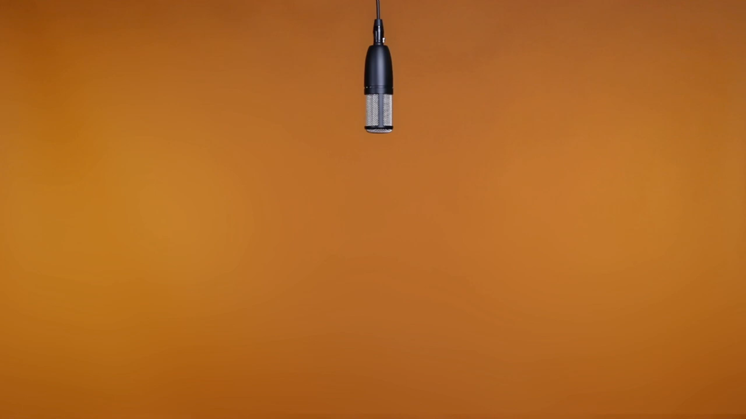
WHY MISOGYNY IS A HATE CRIME
Please Ctrl + Click the image to view:

Slide 28
misogyny: a hate crime?
A hate crime refers to criminal offences which are motivated by prejudice against elements of a person’s identity.
Crimes which are categorised as such can lead to tougher or ‘enhanced’ sentencing, in recognition of the additional harm that is caused when someone is targeted for who they are.
Including misogyny within this framework would mean that the behaviours women experience every day because of their gender, whether on the street, in public spaces or online, would be recognised for the discrimination and power imbalances that underpin them.
To report a hate crime you can call 101 if it isn't an emergency or complete an online form at: https://www.gov.uk/report-hate-crime

Slide 29
misogyny: a hate crime?
SEXUAL ORIENTATION/IDENTITY
rACE
A sexual orientation hate crime could target someone who is not themselves from the targeted group and the harmed person could be, for example, the child of a same-sex couple or someone mistaken as having a particular sexual orientation, so long as the offender was motivated, wholly or partially, by a hostility to that sexual orientation.
Racially motivated Hate Crimes are the highest reported type of Hate Crime in the UK. A total of 109,843 racially aggravated offences were recorded in 2021/2022
RELIGION
dISABILITY
Disability Hate Crimes (DHC) are attacks against disabled people. These are often different from other hate offences in that these might be perpetrated by friends, family members or carers. This also means that disability hate crimes are less likely to be reported. Hostility against disabled people is happening in public, in the privacy of people’s homes and in care settings.
Religious Hate Crimes occur when someone is targeted because of their identity to a Religious group.
A religious group means a group of people who share the same religious belief such as Muslims, Hindus and Christians. It also includes people with no religious belief at all.

Slide 30
A hate crime?
The Law Commission concluded in its ‘Hate Crime Laws: Final Report (published 7 December 2021) that making misogyny a hate crime may be: “more harmful than helpful, both to victims of violence against women and girls, and also to efforts to tackle hate crime more broadly” and that “…we have reached the view that hate crime recognition would not be an effective solution to the very real problem of violence, abuse and harassment of women and girls in England and Wales, and may in fact be counterproductive in some respects.”

Slide 31
Self care
Listen to music
Exercise
Volunteer
Play games
Go out for a coffee

Slide 32
Welsh Women's Aid
Diolch
Thank you
Pendragon House, Caxton Place, Pentwyn, Cardiff, CF23 8XE
02920 541 551
info@welshwomensaid.org.uk
cyberbully-ing
www.welshwomensaid.org.uk
Follow us:
@welshwomensaid
Workshop informed by
Welsh Women’s Aid is a registered charity in England and Wales, No. 1140962 and a company limited by guarantee registered in England and Wales, No. 07483469.

