Slide 1







RELATIONSHIPS

Slide 2
Welcome

Slide 3


Overview
  Relationships – what is healthy, what isn’t as healthy.
  Coercive control and where is the line?
  Consent and the law
  Activism – how you can spread the message within your community
  Help and advice
Trigger warning
Some content in this training might be triggering

Slide 4





What are relationships?
  A bond between two people that have things in common (friends, partners, family members)
  Relationships can be romantic, platonic or mutual
  Relationships are based on connection
Notes:
Listed in slide are CYP’s answers.
Check if CYP want to add anymore answers to this slide or would like to edit anything.
3

Slide 5
group work

Slide 6



Types of relationships
Types of relationships...
  Split the group into two teams.
  Each team has one flipchart and one sharpie per group.
  Children and Young People have 2 minutes to list as many people as possible who can have relationships with.
  Individually each person must make their way to the flipchart write a type of relationship down, once this has been completed, they pass their sharpie back to their next team member.
  Get ready...!
RULES...
  No physical contact with others.
  No copying the other team.
  If you list something more than once, you will only gain one point.
Notes:
4

Slide 7









Feedback
Friends
People online
Partners
Parents
Co-workers
Siblings
Teachers

Slide 8
Drawing Exercise
  What values would they have?
  What would they be saying?
  How would they both or how would one of them be feeling?
  How would they be acting?
Notes:
4

Slide 9





What does a healthy relationship look like?
Talking about things that upset them
Caring about each other
Supporting each other
Having someone you can talk to about things
Listen, help, respect them
Feeling happy when around them
Notes:
Feeling happy when around them
Caring about each other
Supporting each other
Talking about things that upset them
Listen, help, respect them
Having someone you can talk to about things
7

Slide 10

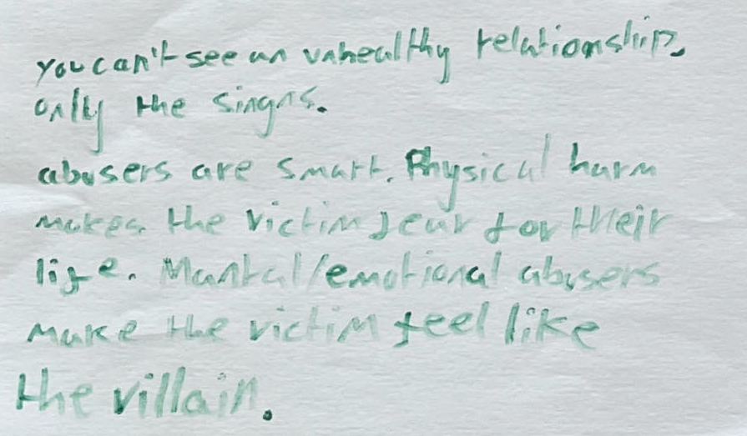
What does a not so healthy relationship look like?
  Violence
  Chasing people
  Arguing
  Saying harmful things
  Bullying
  Calling names

Slide 11

Let’s hear your say!
Not okay!!
That is okay!
I wouldn’t mind.
Notes:
9

Slide 12


You make joint decisions together.

Slide 13

They say they will give you money if you send a selfie to them.

Slide 14

They put you down in a joking way.

Slide 15

They know where you are always.

Slide 16

They pressure you or guilt you into doing something you don’t want to do.

Slide 17

They have their own life, and you see them only at weekends.

Slide 18

They say they will give you more money if you send them a nude photo.

Slide 19
Break

Slide 20


Red Flag / Green Flag

Slide 21
red Flag
  Abusive
  Aggression
  Untrustworthy
  Unloyalty
  Unhelpful
  Bribery
  Rude to family
  Secretive
  Insults
  Talks bad about you
  Being mean
  Telling people what to do
  Toxic
  Overprotective
  Controlling
  Hot and cold
  Love bombing
  Dependence
  Humiliation
  Unfair power

Slide 22
green Flag
  Trust
  Respect
  Understanding
  Non- toxic
  Loyal
  Communication
  They have your back
  Thoughtfulness
  Encouragement
  Supportive
  Helpful
  Equal effort
  They have their own life
  Protective by not too much
  You feel happy when you are around them
  Kind to family
  Open to you
  Talks good about you
  Calm
  Communication
  Boundaries
  Have things in common with them
  You can open up to them

Slide 23

love bomb
Notes:
Video is just over 10 minds.
Ask CYP to watch the film and make a note of every time they find something concerning or they see a red flag.
At the end of the film feedback.
20

Slide 24
What did you notice?

Slide 25
What is coercive control?
  Coercive control is an act or a pattern of acts of assault, threats, humiliation and intimidation or other abuse that is used to harm, punish, or frighten their victim.
  This controlling behaviour is designed to make a person dependent by isolating them from support, exploiting them, depriving them of independence and regulating their everyday behaviour.
  Coercive control is a criminal offence.
Notes:
Listed in slide are CYP’s answers.
Check if CYP want to add anymore answers to this slide or would like to edit anything.
3

Slide 26

Where is the line?
  They text you every day to see how you are doing.
  They tell you how nice you are.
  They want to be with you all the time.
  They turn up at your home uninvited with a present on your birthday.
  They get annoyed if you don’t text them back straight away.
  They tell you that without you they are nothing.
  They tell you that you are paranoid and that you make things up.
  They tell you other people in your life don’t respect you or like you.
Notes:
23

Slide 27
Break

Slide 28
What is consent?
  Consent is when two people agree on the same thing.
  It’s not just about romantic relationships.
Notes:
Listed in slide are CYP’s answers.
Check if CYP want to add anymore answers to this slide or would like to edit anything.
3

Slide 29
Your Bubble activity
Think of boundaries as bubbles that protect us.
Imagine everyone has an invisible bubble surrounding them.
This bubble is our “boundary” both physically and emotionally.
Notes:
Why are boundaries so important?
The reality is we can’t control other people’s actions or words. Instead, we can focus on what we can control, which is our response. By working to establish boundaries, we can find our mood less affected by the negative actions or words of others.
When we’re clear about our boundaries, it helps other people understand our expectations for how we want to be treated. In this way, boundaries build lasting and satisfying relationships with friends, family and romantic partners.
Activity
CYP to draw a person and a bubble surrounding that person. Put all things they are okay with in the middle e.g. a friend hugging them or saying ‘no’ without guilt.
Then ask them to draw around the bubble things they are no okay with e.g. feeling pressured into doing something they don’t want to do or unwanted physical touch.
Have a discussion with CYP about their drawings and how they can put boundaries in place and uphold them.
26

Slide 30
Knowing the law
Under 16 years old
  If you have sex when you are younger than 16, you are breaking the law – even if you are both the same age.
  Although the age of consent is 16, if you both want to have sex with each other, and you’re a similar age, the police may decide not to take any action. If one of you is 15 and the other is much younger – may be 13, then the police, and others, might be worried that there is a problem. Even if the police decide not to take any action, your parents may be cross or upset and concerned that you are having sex before you are legally allowed to.
  You can’t give consent to have sex if you are under 13, so if you have sex with someone under 13, you could be arrested. You could even end up with a criminal record which stays with you your whole life. If you are the one who is under 13, you won’t be in trouble with the police, but your parents may be concerned and upset about what has happened.
Notes:
23

Slide 31
Knowing the law
16 years +
  In Wales, the age of consent is 16. This is when the law says you are old enough to give consent to have sex. This doesn’t mean you have to have sex once you are 16 if you don’t want to. It does mean that if you are under 16 and have sex with someone who is older than 16, the person you have sex with could get into trouble.
Notes:
23

Slide 32

Activism
Talk to people you know about what you have learnt (friends, family, teachers, youth workers)
Create artistic posters and put them in the community
Post on social media or re-post
Speak in assemblies in school
Notes:
9

Slide 33
Advice
Talk to someone you trust (teacher, key worker, friend etc.)
Don’t be scared reach out!
Check in on people around you
Notes:
9

Slide 34
Signposting

Slide 35






Welsh Women's Aid
Diolch
Thank you
Pendragon House, Caxton Place, Pentwyn, Cardiff, CF23 8XE
02920 541 551
info@welshwomensaid.org.uk
cyberbully-ing
www.welshwomensaid.org.uk
Follow us:
@welshwomensaid
Workshop informed by
Welsh Women’s Aid is a registered charity in England and Wales, No. 1140962 and a company limited by guarantee registered in England and Wales, No. 07483469.

