Slide 1
Misogyny

Slide 2
Introductions & Group agreement
Hate has no home here
Show others the respect you wish to receive
Respect is a two-way street

Slide 3
Overview of the workshop
Values
Patriarchy
Misogyny
Group activity - let’s bring out values back
Misogyny - a hate crime?
Positive role models
She is SOMEONE
A pledge
Trigger warning
Some content in this training might be triggering

Slide 4
Lets start with an ice breaker

Slide 5
Accountable
Adaptable
Adventurous
Agreeable
Altruistic
Analytical
Articulate
Artistic
Assertive
Attentive
Balanced
Calm
Candid
Careful
Caring
Cheerful
Circumspect
Collaborative
Committed
Compassionate
Competitive
Concise
Confident
Considerate
Constructive
Co-operative
Co-ordinated
Courteous
Creative
Decisive
Dedicated
Dependable
Determined
Devoted
Direct
Disciplined
Driven
Dynamic
Eager
Efficient
Eloquent
Empathetic
Encouraging
Energetic
Engaging
Enterprising
Enthusiastic
Entrepreneurial
Expressive
Fair
Flexible
Focused
Friendly
Fun
Funny
Generous
Gentle
Graceful
Grateful
Gregarious
Hard-working
Helpful
Honest
Humble
Imaginative
Industrious
Innovative
Insightful
Inspiring
Intuitive
Just
Kind
Logical
Loyal
Methodical
Moderate
Modest
Motivated
Nurturing
Objective
Observant
Open-minded
Optimistic
Orderly
Organised
Original
Patient
Perceptive
Personable
Polite
Positive
Practical
Precise
Productive
Professional
Punctual
Persuasive
Realistic
Receptive
Reliable
Resourceful
Respectful
Responsible
Sincere
Sympathetic
Tenacious
Thorough
Trustworthy
Visionary
Stand
by your values
Tip: Remember your values as we will use them later in the session.
Notes:
https://www.ncbi.nlm.nih.gov/pmc/articles/PMC5734543/

Slide 6
Let’s start with
Patriarchy...
Male dominated
Rape culture
Shaming language
Unequal pay
Violence against women
Unrealistic beauty standards
Gender roles

Slide 7
What is the patriarchy?
Patriarchy refers to a society dominated by cis men. Patriarchal beliefs of male, heterosexual dominance and the devaluation of girls and women lie at the root of gender-based violence.

Slide 8
How does patriarchy show up in the real world?
Use of man’s surname once married
Pink tax
Can you think of anything else?
Reduced paternity leave leading to women assuming primary caregiving role
Globally, girls have less access to education
Paying for period products
Most medical research is done with men

Slide 9
Gender imbalance
in leadership and decision-making roles

Slide 10
Let’s have a look at this
Women make up 31% of UK parliamentarians
Women make up 30% of senior judicial positions.
Since 1902 there have been 25 prime ministers.
69%
31%
70%
30%
87%
12%
Notes:
Teacher to point out the issue with stereotypical photo representing men and women.

Slide 11
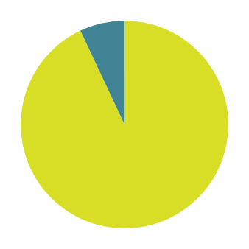
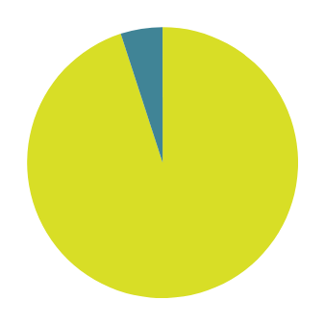
Let’s have a look at this
Minoritised groups make up 7% of UK parliamentarians
Minoritised groups make up 5% of senior judicial positions.
Since 1902 there has been 1 prime minister from a minoritised group.
93%
7%
95%
5%
96%
4%

Slide 12
group work
Choose a gender
Woman
Man
Transgender woman
Transgender man
Non-binary
Gender-fluid/A gender/Gender Non conforming
How does patriarchy effect them
Notes:
https://www.ncbi.nlm.nih.gov/pmc/articles/PMC5734543/

Slide 13
the negative effect of the patriarchy
Feminism perceived as radical by the media, discouraging people from standing up for equality
Men who aren't viewed as stereotypically masculine are viewed with contempt.
Pressure to conform to narrow idea of what a man should be.
Patriarchy reinforces sexist attitudes and beliefs and provides men with the power to act on them.
Feeling shame about seeming vulnerable or expressing “unmasculine” emotions like fear, sadness, or worry.
Patriarchal thinking can comfortably incorporate other biases—ableism, classism, or white supremacy, for instance—that offer one group dominance over others.
Men are less likely to seek out support for their mental health.

Slide 14
What do we need to know about
misogy﻿ny...
Discrimination
Victim-blaiming
Gender inequality
Sexism
Double standards
Toxic masculinity
Oppression

Slide 15
What is misogyny?
Misogyny is hatred of, contempt for, or prejudice against women. It is a form of sexism that is used to keep women at a lower social status than men, thus maintaining the social roles of patriarchy.

Slide 16
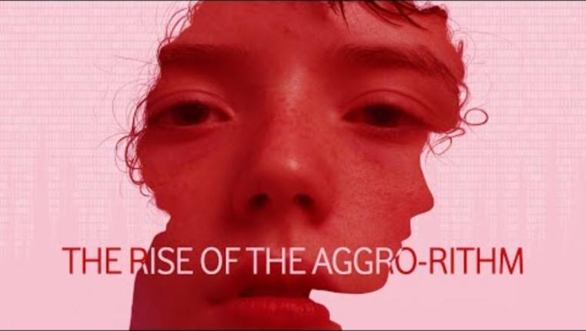
The rise of the aggro-rithm

Slide 17
Discuss these resources

Slide 18
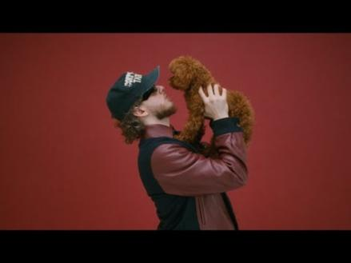
Or even if you listen closely, this...
“I'm vanilla, baby, I'll choke you, but I ain't no killer, baby (I don't like no whips and chains)​
She stole my heart, then she got archived​
I keep it short with a b*, Lord Farquaad​
If you came with a man (yeah, yeah)​
Let go of his hand (let go of that)​
Everybody in the suite, kicking up they feet, stand up, b*, dance”

Slide 19
Misogyny = Toxic masculinity
Toxic masculinity involves the extreme pressure some men may feel to act in a way that is harmful.
Researchers have come to an agreement that is has 3 components.
Toughness: Physically, emotionally,
behaviourally.
Anti-feminity: Rejection of anything
feminine.
Power: Assumption that they must
have power and status for respect.
racism
anti-semiticm
homophobia
transphobia
misogynistic attitudes

Slide 20
iNTERNALISED MISOGYNY
Internalised misogyny is when women projects sexist ideals onto other women and onto themselves.
Notes:
This would affect everyone, regardless of how they identify as society often tries to place us in a gender binary

Slide 21
Internalised misogyny, For example
Example
Math is more a guy thing
That’s not ladylike
Girls are drama
A
I don’t need feminism, I believe in equality
She is just jealous of you
Example
I am not like other girls
I am all natural
B
Notes:
This would affect everyone, regardless of how they identify as society often tries to place us in a gender binary

Slide 22
What do you think?

Slide 23
Let’s Bring our values back!
Consider the statement presented.
What do you think about it?
If you think it is harmful, how could you use your top value to challenge the statement in a safe way?

Slide 24
GROUP WORK

Slide 25
What do you think about this statement?
Boys will be boys
How could you use one of the values you have chosen?

Slide 26
What do you think about this statement?
I think he just needs to man up!
How could you use one of the values you have chosen?

Slide 27
What do you think about this statement?
Misogyny is absolutely wrong, whether it’s a man against a woman or a woman against a man.
How could you use one of the values you have chosen?
Quote from Dominic Raab

Slide 28
What do you think about this statement?
Girls are too emotional to be leaders
How could you use one of the values you have chosen?

Slide 29
What do you think about this statement?
He throws like a girl
How could you use one of the values you have chosen?

Slide 30
What do you think about this statement?
He throws like a girl
How could you use one of the values you have chosen?

Slide 31
misogyny:
a hate crime?

Slide 32
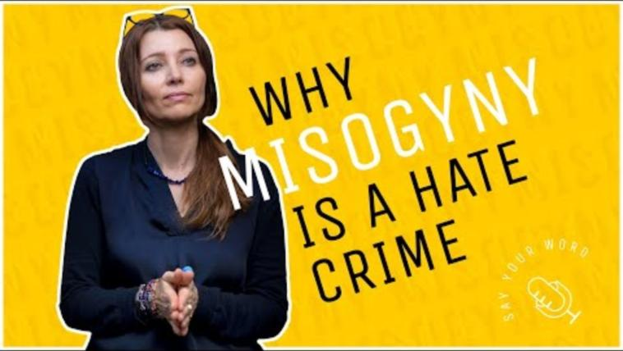
WHY MISOGYNY IS A HATE CRIME

Slide 33
misogyny: a hate crime?
A hate crime refers to criminal offences which are motivated by prejudice against elements of a person’s identity.
Crimes which are categorised as such can lead to tougher or ‘enhanced’ sentencing, in recognition of the additional harm that is caused when someone is targeted for who they are.
Including misogyny within this framework would mean that the behaviours women experience every day because of their gender, whether on the street, in public spaces or online, would be recognised for the discrimination and power imbalances that underpin them.
To report a hate crime you can call 101 if it isn't an emergency or complete an online form at: https://www.gov.uk/report-hate-crime

Slide 34
misogyny: a hate crime?
SEXUAL ORIENTATION/IDENTITY
rACE
A sexual orientation hate crime could target someone who is not themselves from the targeted group and the harmed person could be, for example, the child of a same-sex couple or someone mistaken as having a particular sexual orientation, so long as the offender was motivated, wholly or partially, by a hostility to that sexual orientation.
Racially motivated Hate Crimes are the highest reported type of Hate Crime in the UK. A total of 109,843 racially aggravated offences were recorded in 2021/2022
RELIGION
dISABILITY
Disability Hate Crimes (DHC) are attacks against disabled people. These are often different from other hate offences in that these might be perpetrated by friends, family members or carers. This also means that disability hate crimes are less likely to be reported. Hostility against disabled people is happening in public, in the privacy of people’s homes and in care settings.
Religious Hate Crimes occur when someone is targeted because of their identity to a Religious group.
A religious group means a group of people who share the same religious belief such as Muslims, Hindus and Christians. It also includes people with no religious belief at all.

Slide 35
A hate crime?
The Law Commission concluded in its ‘Hate Crime Laws: Final Report (published 7 December 2021) that making misogyny a hate crime may be: “more harmful than helpful, both to victims of violence against women and girls, and also to efforts to tackle hate crime more broadly” and that “…we have reached the view that hate crime recognition would not be an effective solution to the very real problem of violence, abuse and harassment of women and girls in England and Wales, and may in fact be counterproductive in some respects.”

Slide 36
What are your thoughts on everything you have just heard?

Slide 37
Role models
Think of some positive role models and the values they have that make them a role model.
Zara Sultana
Rosa Parks
Sylvia Rivera

Slide 38
She is someone.’s sister /mother/daughter/wife.

Slide 39
Make one pledge to help stop misogyny?

Slide 40
SIGNPOSTING
https://...
Live Fear Free helpline
Swansea Women's Aid
Childline

Slide 41
Self care
Listen to music
Exercise
Volunteer
Play games
Go out for a coffee

Slide 42
Welsh Women's Aid
Diolch
Thank you
Pendragon House, Caxton Place, Pentwyn, Cardiff, CF23 8XE
02920 541 551
info@welshwomensaid.org.uk
cyberbully-ing
www.welshwomensaid.org.uk
Follow us:
@welshwomensaid
Workshop informed by
Welsh Women’s Aid is a registered charity in England and Wales, No. 1140962 and a company limited by guarantee registered in England and Wales, No. 07483469.

